Slide 1
Android Life Cycle
Notes:
A startup or splash screen
This activity serves as the primary entry point to the application. It displays the application name and version information, and transitions to the main menu after a short interval.
A main menu screen
This activity acts as a switch to drive the user to the core activities of the application. Here, the users must choose what they want to do within the application.
A game play screen
This activity is where the core game play occurs.
A high scores screen
This activity might display game scores or settings.
A Help/About screen
This activity might display the information the user may need to play the game.

Slide 2
Performing Application Tasks with Activities
A simple game application might have the following five activities:
  Startup or splash screen
  Main menu screen
  Game play screen
  High scores screen
  Help/About screen
Notes:
A startup or splash screen
This activity serves as the primary entry point to the application. It displays the application name and version information, and transitions to the main menu after a short interval.
A main menu screen
This activity acts as a switch to drive the user to the core activities of the application. Here, the users must choose what they want to do within the application.
A game play screen
This activity is where the core game play occurs.
A high scores screen
This activity might display game scores or settings.
A Help/About screen
This activity might display the information the user may need to play the game.

Slide 3
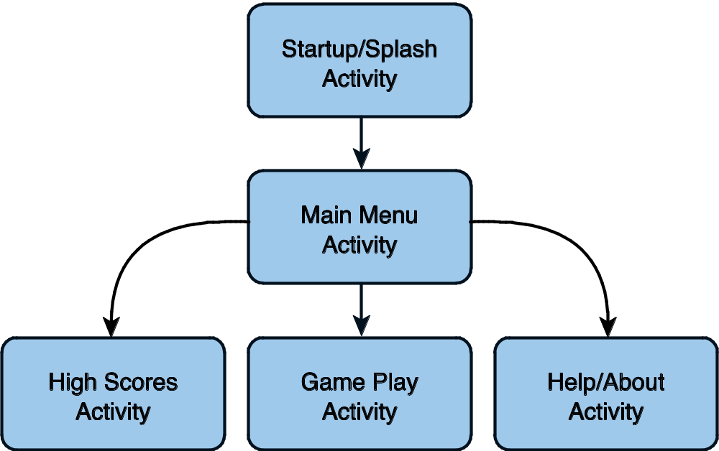
Performing Application Tasks with Activities (Cont’d)
Notes:
A representation of how to perform the activities in the application

Slide 4
Lifecycle of an Android Activity
Android apps can be multiprocess.
Android allows multiple apps to run concurrently (provided memory and processing power are available).
Applications can have background behavior.
Applications can be interrupted and paused when events such as phone calls occur.
There can be only one active application visible to the user at a time—specifically, a single application Activity is in the foreground at any given time.

Slide 5
Lifecycle of an Android Activity (Cont’d)
Android keeps track of all Activity objects running by placing them on an Activity stack.
The Activity stack is referred to as the “back stack.”
When a new Activity starts, the Activity on the top of the stack (the current foreground Activity) pauses, and the new Activity pushes onto the top of the stack.
When that Activity finishes, it is removed from the Activity stack, and the previous Activity in the stack resumes.

Slide 6
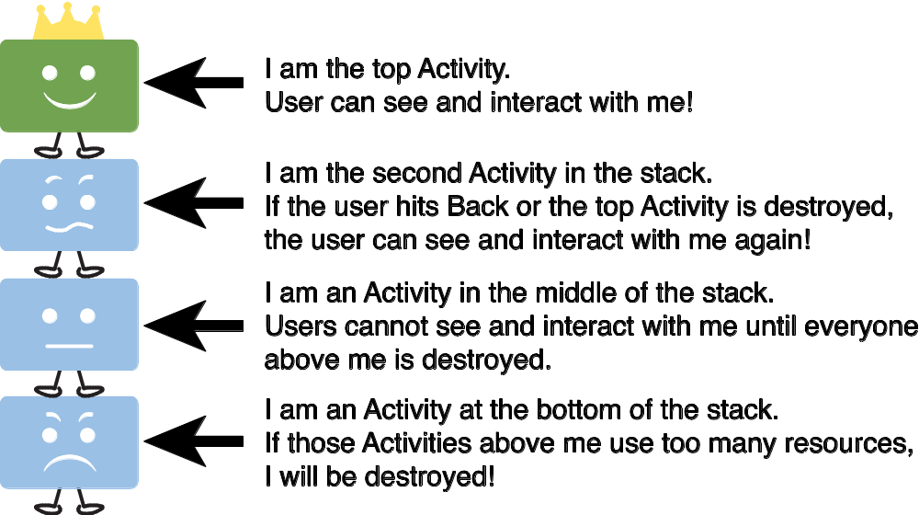
Lifecycle of an Android Activity (Cont’d)
Notes:
The Activity stack

Slide 7
Using Activity Callbacks to Manage App State and Resources
public class MyActivity extends Activity {
protected void onCreate(Bundle savedInstanceState);
protected void onStart();
protected void onRestart();
protected void onResume();
protected void onPause();
protected void onStop();
protected void onDestroy();
}
Notes:
Android applications are responsible for managing their state and their memory, resources, and data.
They must pause and resume seamlessly.
Understanding the different states within the Activity lifecycle is the first step in designing and developing robust Android applications.
These are the method stubs for the most important callbacks of the Activity class.

Slide 8
Initializing Static Activity Data in onCreate()
When an Activity first starts, onCreate() is called.
onCreate() has a single parameter, a Bundle (null if newly started Activity).
If this Activity is a restarted Activity, Bundle contains previous state information so that it can reinitiate.
  Perform setup (layout and data binding), such as setContentView(), in onCreate().

Slide 9
Initializing and Retrieving Activity Data in onResume()
When the Activity reaches the top of the stack and becomes the foreground process, onResume() is called.
This is the most appropriate place to retrieve any instances of resources (exclusive or otherwise) that the Activity needs to run.
These resources are the most process intensive, so we keep them around only while the Activity is in the foreground.

Slide 10
Tip
The onResume() method is often the appropriate place to start audio, video, and animations.

Slide 11
Stopping, Saving, and Releasing Activity Data in onPause()
When another Activity moves to the top of the stack, Activity is informed and pushed down the stack by onPause().
Stop audio, video, and animations started in onResume().
Deactivate resources such as database Cursor or other objects that should be cleaned up should your Activity be terminated.
onPause() may be the last chance for the Activity to clean up and release any resources it does not need while in the background.
Save uncommitted data in case your application does not resume.
The system has a right to kill an Activity without further notice after calling onPause().
Save state information to Activity-specific preferences or application-wide preferences.
Perform anything in onPause() in a timely fashion. The new foreground Activity is not started until onPause() returns.

Slide 12
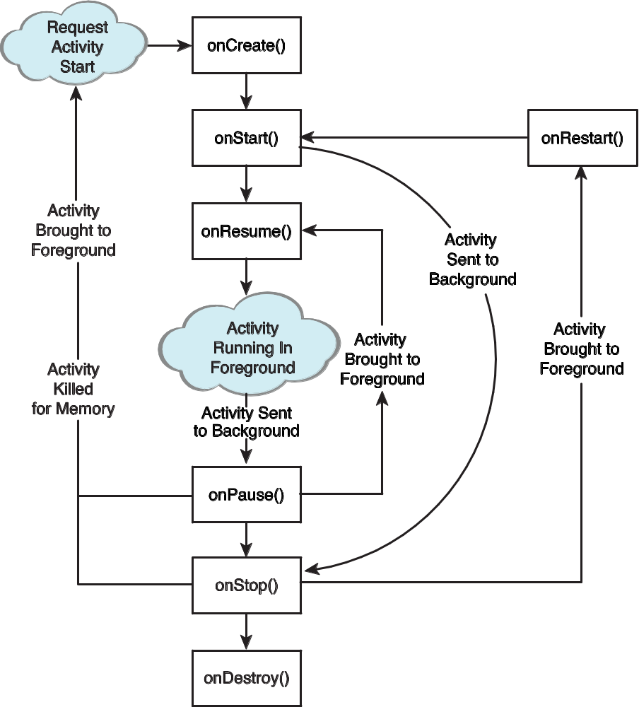
Lifecycle of an Android Activity
Notes:
Here, we can see a visual representation of how Activity callback methods are related to one another.

Slide 13
Warning!
Any resources and data retrieved in onResume() should be released in onPause()! If they aren’t, some resources may not be cleanly released if the process is terminated!

Slide 14
Avoiding Activities Being Killed
If the Activity is killed after onPause(), the onStop() and onDestroy() methods will not be called.
The more resources released by an Activity in the onPause() method, the less likely the Activity is to be killed while in the background without further state methods being called.
Notes:
Under low-memory conditions, the Android operating system can kill the process for any Activity that has been paused, stopped, or destroyed.
This essentially means that any Activity not in the foreground is subject to a possible shutdown.
The act of killing an Activity does not remove it from the Activity stack.
Instead, the Activity state is saved into a Bundle object, assuming the Activity implements and uses onSaveInstanceState() for custom data, although some View data is automatically saved.
When the user returns to the Activity later, the onCreate() method is called again, this time with a valid Bundle object as the parameter.

Slide 15
Saving Activity State with onSaveInstanceState()
If an Activity is vulnerable to being killed by Android, you can save state info to a Bundle with onSaveInstanceState().
  This call is not guaranteed, so use onPause() for essential data commits.
What is recommended?
  Save important data to persistent storage in onPause(), but use onSaveInstanceState() to start any data that can be used to rapidly restore the current screen to the state it was in (as the name of the method might imply) .

Slide 16
Tip
You might want to use the onSaveInstanceState() method to store nonessential information such as uncommitted form field data or any other state information that might make the user’s experience with your application less cumbersome.

Slide 17
Saving Activity State with onSaveInstanceState() (Cont’d)
When this Activity is returned to later, this Bundle is passed in to the onCreate() method, allowing the Activity to return to the exact state it was in when the Activity paused.
You can also read Bundle information after the onStart() callback using onRestoreInstanceState().
When the Bundle information is there, restoring the previous state will be faster and more efficient than starting from scratch.

Slide 18
Destroying Static Activity Data in onDestroy()
When an Activity is being destroyed in the normal course of operation, the onDestroy() method is called.
The onDestroy() method is called for one of two reasons:
  The Activity completed its lifecycle voluntarily.
  The Activity is being killed by the OS because it needs the resources (but still has the time to gracefully destroy your Activity).

Slide 19
Tip
isFinishing() returns false if the Activity has been killed.
This method can be helpful in onPause() to know if the Activity is not going to resume right away.
The Activity might still be killed in onStop() at a later time.
You may be able to use this as a hint to know how much instance state information to save or permanently persist.

